Slide 1
2023 st. Patrick’s Ministry Fair

Slide 2
Acolytes
Contact: Doug Schultz, schultzhouse371@gmail.com
Looking for a few good Men, Women, Girls, & Boys to serve the church up front and lead the congregation every Sunday and on selected other worship days.
With enough people you would only have to serve 1 Sunday a month 2 weeks a year.
Come and see the service, the congregation, the church from a different perspective.
Be one of the Brave, the Proud, the one who is an Acolyte.

Slide 3
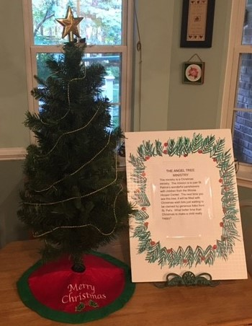
Angel Tree
Contact: Jim and Sandy Welch, jswelch7616@gmail.com
Angel Tree is a Christmas ministry. The mission is to give St. Patrick’s wonderful parishioners the opportunity to help give the children from the Winnie Hooper Center a joyful Christmas. The next time you see this tree will be a reminder that it’s time to make an Angel Tree donation toward gift cards for these children. What better time than Christmas for the generous folks at St. Patrick’s to make a child happy?

Slide 4
Back 2 School Bash (B2SB)
Contact: Pete Sale, pete.sale@jeffersonwells.com
The goal of the Back 2 School Bash (B2SB) is to help prepare children of Iredell County for the start of a new school year. This year, 1,100 students were served, and St. Patrick’s was a Platinum Sponsor donor. Over 50 pairs of shoes were contributed by St. Patrick’s at this year’s B2SB. Kids jump higher and run faster because of their new shoes. We helped create many, many smiles. The highlight was while helping these kids try on their new shoes, one could look into the kids’ eyes and see the face of Jesus.

Slide 5
Brawley Crawleys
Contact: Kathy Yager, kathleen.a.yager@gmail.com
This study group evolved from a Lenten group nearly ten years ago and before Brawley Road was widened, hence the name. The idea was to enlarge the scope of our religious understanding through reading books written by various religious scholars and openly discussing what each of us gleaned from the assigned reading. The purpose is to broaden the exposure of each individual to differing perspectives with the hope that each of us can discover a deeper sense of spirituality.

Slide 6
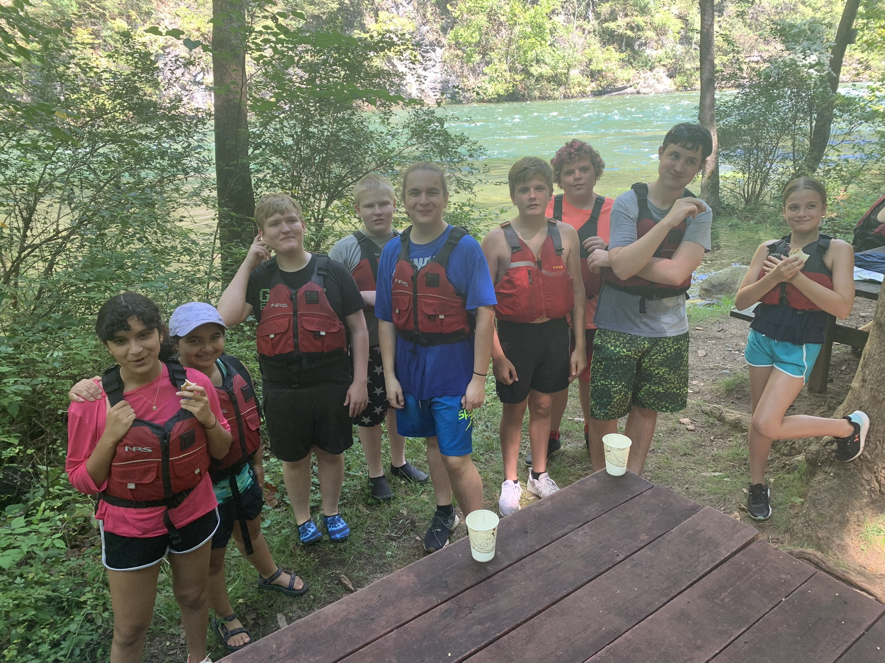
Children, Youth and Family
Contact: Ami O’Neill, aoneillphd@gmail.com
Our CYF ministry is founded upon two pillars, namely, a sound theological education and a commitment to community service. For the Christian, contemplation and action are inseparable components of a mature spiritual life. On top of our commitment to education and service, we are dedicated to fostering a welcoming and inclusive environment where our children and youth can build life-long friendships through participating in exciting extra-curricular activities like whitewater rafting, skiing and snowboarding, family bowling nights, and much more. We hope you will join us for what is promising to be a terrific 2023-2024 programming year!

Slide 7
Coffee Hour
Contact: Denise Watson, dendebwat@gmail.com
As a part of feeding our body, mind, and spirit, we would like to host a reimagined coffee program. As we have done previously, we would like to meet following the 10:30 a.m. service to share a cup of coffee, a light refreshment, and offer each other encouragement for the upcoming week. To help drive the success of this ministry, we need volunteers to serve the coffee and refreshment, and provide fellowship. We would like to host our first Coffee & Fellowship in early November. To volunteer, please sign-up via SignUp Genius (see the Weekly News 10.5.23 edition), or contact Denise Watson at dendebwat@gmail.com

Slide 8
Communications
Calling creative people to join our team
Social Media
Website
Print
Photography
Interested? Contact Julie Klapp, jjklapp@gmail.com

Slide 9
Daughters of the King
Contact: Linda Bondurant, linda.bondurant@gmail.com
The Daughters of the King is an organized religious order. Each daughter takes a vow to live by the Rule of the order. This rule requires a spiritual discipline of daily prayer, service and evangelism. Our chapter, St. Brigid, meets monthly at the church. We come together and support each other, update our prayer list and have Bible study. For further information, please contact Linda Bondurant (703-599-0491).

Slide 10
ECW
Contact: Dori King, dorijanking@gmail.com, 704-533-3039
All women of Saint Patrick’s are invited to join Episcopal Church Women. Our members are of all ages, ethnic origins, and socioeconomic backgrounds, sharing a variety of points of view. However, our common denominator is a love of God and the wish to do His work. Centered in congregations, we empower women to do Christ’s ministry in the world. We meet on the first Monday of every month at 10:30 a.m.

Slide 11
Education for Ministry (EFM)
Contacts: Kat Sykes, katsgratitude@gmail.com
Mark Fowler, markfowler1952@gmail.com
EFM groups form a bond over 36 weeks of learning per year aided by a Mentor and possibly a Co-Mentor. While it takes four years to complete the program they do not have to be concurrent. Year one is focused on studying the Old Testament by reading Scripture and scholastic books on the Scriptures. Year two focuses on New Testament, year three on the history of Christianity and year four on reading theological books. Theological Reflections form an integral part of each year and are lively discussions reflecting on readings, current events, Christian Tradition, personal experience and belief. All are designed to help you see and live your faith with a new understanding and depth. New classes begin each year in September and meet through May.

Slide 12
Feed NC
St. Patrick’s Contact: Charlotte Lafon, char71mu@yahoo.com
Feed NC Volunteer Contact: Paul Mihelich, pmihelich@feednc.org
Feed NC is an external organization based in Mooresville, NC that is supported by St. Patrick’s. Feed NC provides food stability to local communities through a variety of services. From their Culinary Program to Grassroots Grocery and everything in between, their programs aim to help those in need find access to healthy food, education, and connections.

Slide 13
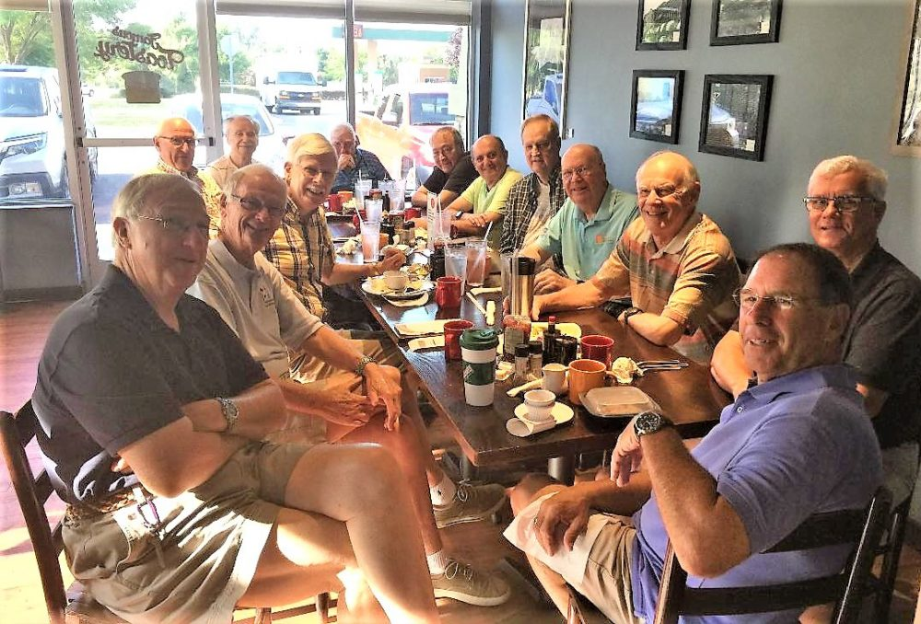
Geezers
Contact: Ted Kratt, tkratt1@gmail.com
These weekly breakfasts came out of a recognition that retired men who have identified themselves through their work in life and have been used to dealing with people regularly tend to find themselves out of sorts when they retire, having difficulty with self-identity and a need for greater socialization. This group started when three or four met for breakfast one Friday morning. They liked it so much that they decided to meet regularly and invite other retired men from the Lake Norman community to join. Meetings are every Friday at 8:00 a.m. to visit and spin yarns.

Slide 14
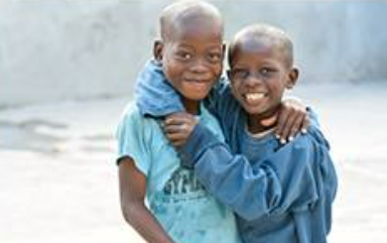
Give Hope Global
Contact: Rick Bashaw, rdbashaw@roadrunner.com
Give Hope Global brings lifelong change through the power of the Good News, good health, good education and good jobs. Our mission is to see the people we serve become able to serve others both spiritually and physically.

Slide 15
HOMe (Hope of Mooresville)
St. Patrick’s Contact: Ginny Stehle, ginny.stehle@gmail.com
HOMe Volunteer Contact: Julie Wooldridge, jwooldridge@windstream.net
HOMe is an external organization based in Mooresville that is supported by St. Patrick’s. Their vision is to provide restorative care in our community for those in a housing crisis. They provide temporary safe shelter and support services to Mooresville’s homeless women and children.

Slide 16
Lectors/Readers
St. Patrick’s Contact: Colleen Ramsey, colleen_822@yahoo.com
On both Sunday services, volunteers are needed to read scripture and Prayers of the People. You don’t need previous experience to participate. If you would like to brush up or improve your public speaking technique, or discover if this ministry is for you, come join us. Please contact Colleen Ramsey at colleen_822@yahoo.com for more information.

Slide 17
Meal Train
Contact: Mary Bilmanis, mary.bilmanis@gmail.com
The Meal Train is a ministry within the Pastoral Care Team at St. Patrick’s. Volunteers respond to requests for meal assistance for families in times of medical and bereavement situations. These requests typically come through the church office. Contact is then made with the family to determine the specific needs and to arrange for time and location of deliveries. If you have questions or would like to volunteer for this important ministry, please contact Mary Bilmanis at 301-643-8602 or email mary.bilmanis@gmail.com.

Slide 18
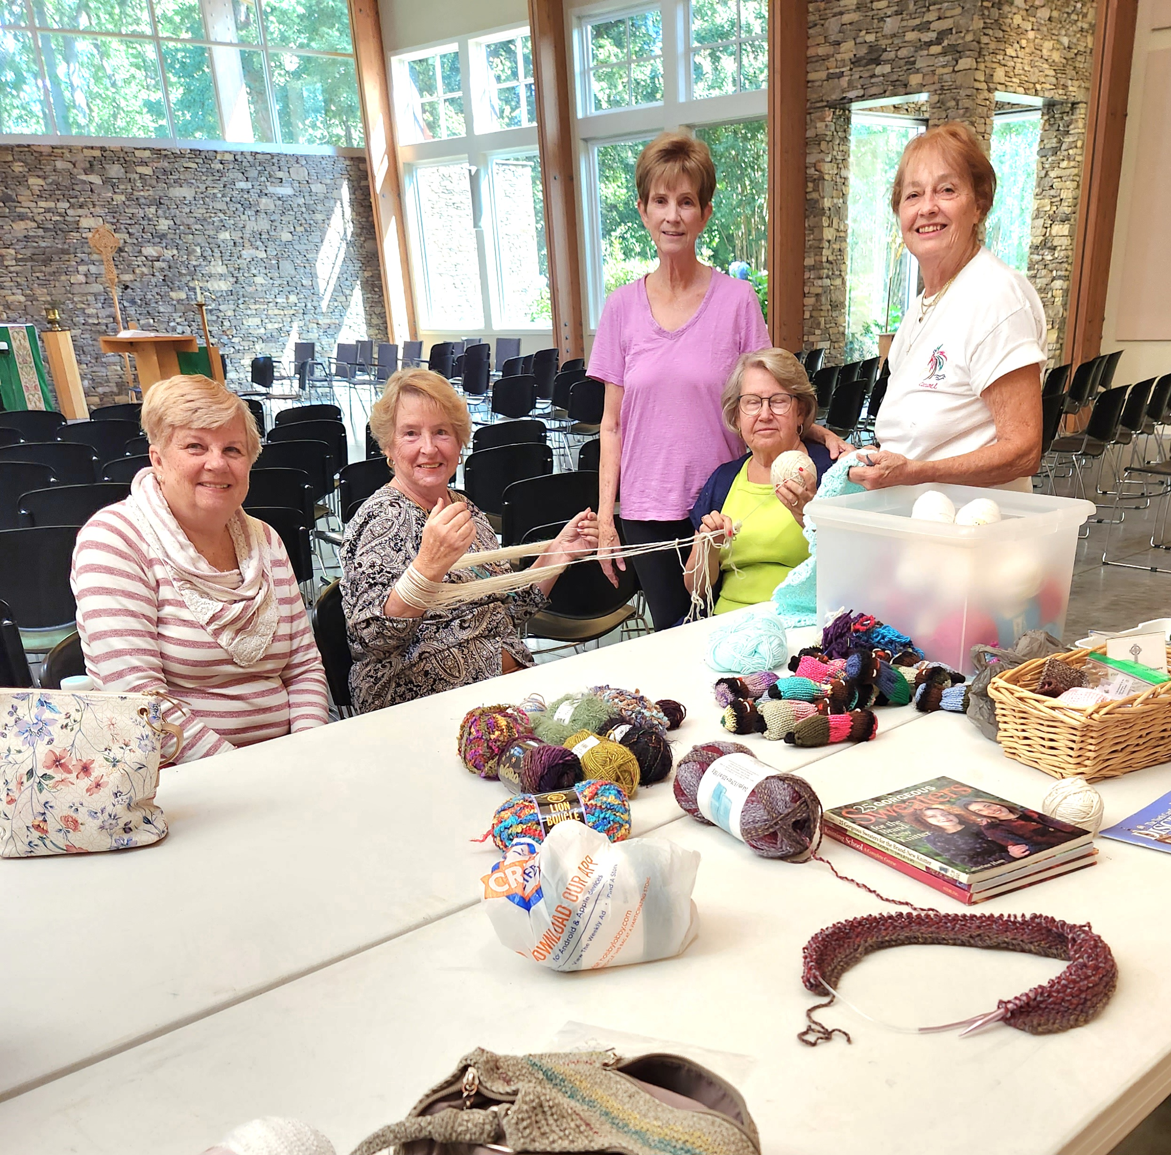
Needleworkers
Contact: Brenda Hartsell, bhartsell@bellsouth.net
The Needleworkers meet Tuesday mornings at 10 a m at St. Patrick's to provide prayer shawls which bring love and/or comfort to those who need it. Anyone who would like to participate but doesn't have knitting or crocheting skills, our members are happy to teach them.

Slide 19
Outreach
Contact: Ginny Stehle, ginny.stehle@gmail.com
Are you passionate about meeting the needs of our local and extended communities? If so, then the Outreach team would love to speak with you. Outreach can help you engage with many avenues of service ranging from Feed NC in Mooresville to 5th Street Ministry in Statesville. No matter what your skills and passion, Outreach has a way for you to serve your community.

Slide 20
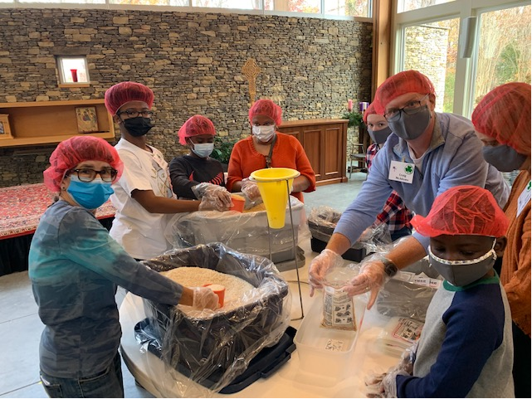
Rise Against Hunger
Contact: Mark Hatley, mark@hatleysales.com
Rise Against Hunger is growing a global movement to end hunger by empowering communities, nourishing lives and responding to emergencies. St. Patrick’s annually participates in a “Meal Packing Event” where 50-60 members package 10,000 meals that are sent to areas of need around the world.

Slide 21
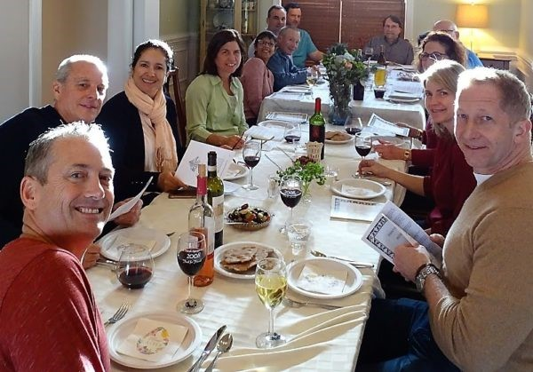
Seekers
Contact: Pam Hatley, pamhatley2@gmail.com
The Seekers are a group of men and women who meet on the second Sunday evening of each month at various members’ homes to deepen our relationships with God and one another. We share food and discussion using video clips, movies, and books as tools.

Slide 22
Skills Sharing
Contact: Kate York, parishadmin@welcomestpat.org
Do you have a skill that could help a fellow parishioner? If so, St. Patrick’s needs you! Our Skill Share Program will connect talented people with church members who need those skills. In exchange for the skill shared, the recipient will make a donation to the church. To participate in sharing your talent, email Kate York at parishadmin@welcomestpat.org, and tell her what talent you’d like to share.

Slide 23
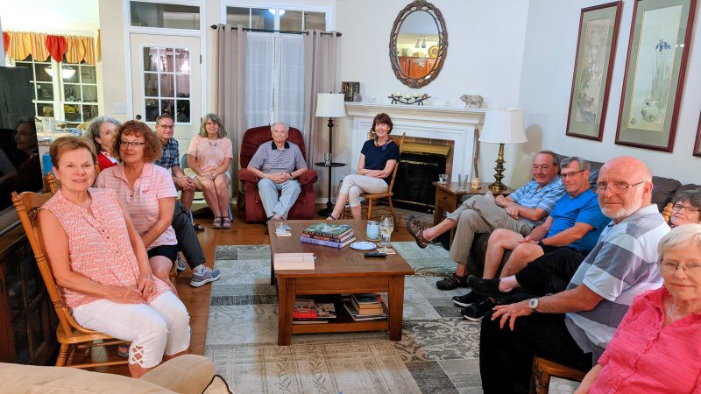
Sojourners
Contact: Jean Messick, messickj@gmail.com
The Sojourners is a fellowship group that is open to all members of St. Patrick’s. We gather on the second Saturday of each month to discuss books, podcasts, movies, etc., that assist us in recognizing how God is with us in our everyday lives.

Slide 24
Stephen Ministry
Contact: Rob Dyess, robertdyess@gmail.com
Stephen Ministers are lay congregation members trained to provide one-to-one care to those experiencing a difficult time in life, such as grief, divorce, job loss, chronic or terminal illness, or relocation.
Stephen Ministers come from all walks of life, but they all share a passion for bringing Christ’s love and care to people during a time of need.

Slide 25
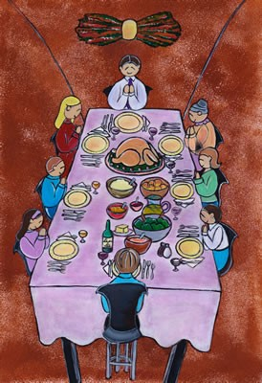
Supper Club
Contact: Jan Krumel, jankrumel@gmail.com
Our Supper Clubs are designed to be purely social, intended to help participants become better acquainted with one another. These groups are a great way to build and strengthen your ties to St Patrick’s. All who sign up for Supper Club will be selected to a group of six people. Each group will decide where, and how often, to meet for a meal. It is suggested that each group recruit two other people, either from within or outside of the congregation. To sign up for Supper Club, contact Jan Krumel at jankrumel@gmail.com

Slide 26
St. Patrick’s Endowment
Contacts: Jan Lamm (jlamm54@gmail.com), David Page (davidjoannapage@aol.com), Ben Adams (bensadamsjr@gmail.com)
St. Patrick's Endowment was established to generate support for our ministries beyond the annual operating budget, and to build a legacy fund that will sustain the work and ministries of the church to future generations.
Income from the endowment will be distributed semi-annually through a grant application.

Slide 27
St. Patrick’s Posey Posse
Contact: Brenda Hartsell, bhartsell@bellsouth.net
Do you like flowers? Can you put them in a vase? St. Patrick's is organizing a Flower Guild to add more personalization to our Sunday flower ministry. Please join us for an organizational meeting between services. We will meet at 9:15 a.m. in the Sanctuary. Feel free to contact Brenda Hartsell at bhartsell@bellsouth.net for more information.

Slide 28
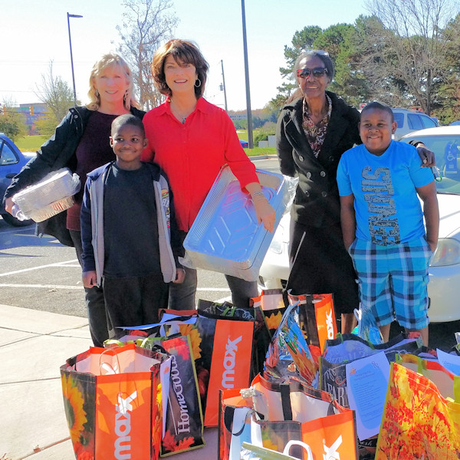
Thanksgiving Meal Drive
Contact: Ginny Stehle, ginny.stehle@gmail.com
It is a St. Patrick’s annual tradition to provide groceries to needy families at Thanksgiving. Our efforts grow each year and more and more families are reached. Be on the lookout for upcoming announcements as to how to provide for our community during the Thanksgiving season.

Slide 29
Ushers
Contact: Pete Sale, pete.sale@jeffersonwells.com
U -sing Christ as an example to service
S –miling, friendly, greeter
H –elping the Holy Spirit touch others
E -ducate visitors
R -epresenting the church
S-ervant to all

Slide 30
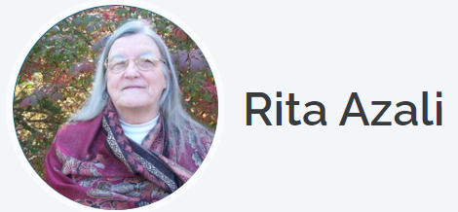
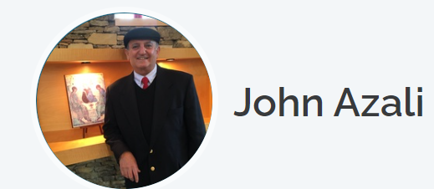
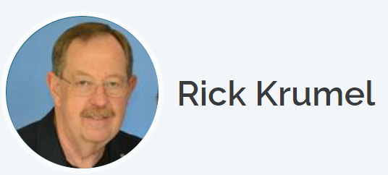
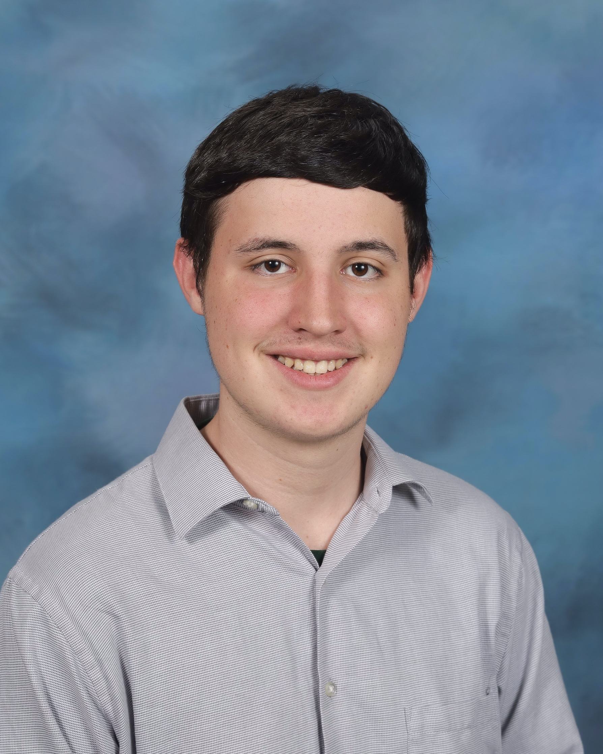
Thank you to all of our special Ministry Fair helpers!

